Slide 1
General Presenter Notes - 1
This talk is designed for neurologists and anyone taking care of patients with severe acute brain injury.
This talk is appropriate for traditional lecture or small groups.
This talk is designed to be presented over 50-60 minutes. While there are less than 30 slides, consider there is a 12 minute video to play.
Ensure that your video and audio function are working before presenting.
Note some slides have animation

Slide 2
General Presenter Notes - 2
When preparing for this presentation, decide which slides you might use and, just as importantly, which you might not use.
If you have a large group, consider breaking off into smaller groups for the practice case and building the range of outcomes within these smaller groups before returning back to review the case as a larger group
Opportunities for making this lecture more interactive include:
  Bring in your own cases
  Share your own personal challenges around prognostic uncertainty and invite audience to share their challenges around the issues presented
  Practice role playing the conversation to present the range of outcomes in the practice case

Slide 3
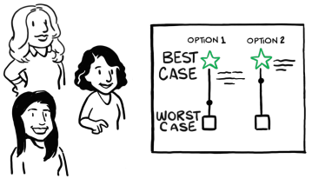
Best Case / Worst Case: Neurology
Jessica Baker, MD, University of Wisconsin, Madison, WI, USA
Jessica Besbris, MD, Cedars-Sinai Medical Center, Los Angeles, CA, USA
Neha M Kramer, MD, Rush University Medical Center, Chicago, IL, USA

Slide 4
Objectives
Examine the illness trajectory of Severe Acute Brain Injury (SABI) as a classic example of prognostic uncertainty
Introduce the purpose and history of the Best Case / Worst Case Framework
Apply the Best Case / Worse Case communication framework to help make high-stakes decisions in the setting of prognostic uncertainty

Slide 5

Severe Acute Brain Injury (SABI)
Stroke
  Ischemic stroke
  Intracerebral hemorrhage
  Subarachnoid hemorrhage
Traumatic Brain Injury
Hypoxic Ischemic Injury (Cardiac Arrest)
12 million
deaths
annually

Slide 6
Severe Acute Brain Injury (SABI)
Acute neurologic catastrophe associated with decreased consciousness or even coma
Chronically can lead to dramatic changes of one’s function, social roles, relationships, personhood
Treatment decisions must be made quickly
Prognostic uncertainty is the RULE
GOC conversations occur with surrogates

Slide 7
SABI Trajectory is Unique
High
Low
High
Low
Prolonged Dwindling
(e.g. dementia)
Function
Function
Short period of decline
(e.g. cancer)
Death
Death
Time
Time
High
Low
Chronic illness with exacerbations
(e.g. chronic heart failure)
High
Low
Severe Acute Brain Injury
Function
Function
Death
Death
Time
Time
Creutzfeldt CJ et al. BMJ 2015

Slide 8
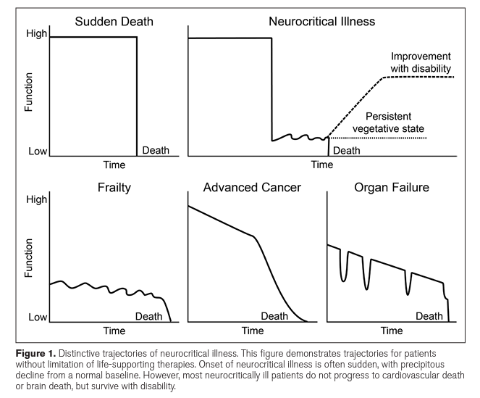
Uncertainty is the RULE in SABI
Prognostic Range
Possible range of outcomes
  Early death
    Typically, after withdrawal/withholding of LST
  Chronic stage of recovery
  Survive for long periods with significant disability
  Enter into a state of disordered consciousness (e.g., vegetative state)
  Shift into another trajectory e.g., prolonged dwindling
Frontera, et al. Critical Care Medicine 2015

Slide 9
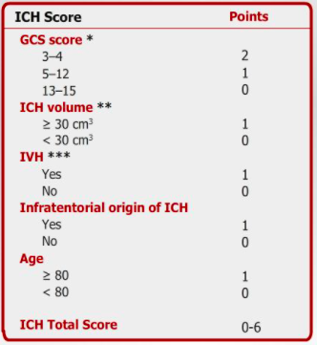
Limitations of SABI Prognostication Tools
Retrospective, and subject to clinical bias
It doesn’t always reflect current practice
Single time point for scoring
Limited number of variables
Self-fulfilling prophecy is baked in

Slide 10
Self-Fulfilling Prophecy
Assumption of a poor prognosis leading to early limitation or withdrawal of life sustaining treatments, thus loss of the potential for recovery and subsequent fulfillment of the prophecy
RESULT = DEATH
ACT
PREDICT

Slide 11
Prognostication
Clinical Presentation
Medical Co-morbidities
Neurologic Reserve
Imaging & Location
Time
Clinical Gestalt

Slide 12

Treatment Decisions along the SABI Continuum
Hyperacute: hrs-1 day
  Goal: Build Trust
  Treatment decisions: intubation/MV, TPA/thrombectomy, hypothermia, EVD placement, decompressive hemicraniectomy, NG tube for urgent medications
  Treatments are life-saving, but may result in a severely disabled state
  Very little time for deliberation
Acute: days-weeks
  Goal: Engage in shared decision making
  Treatment decisions: starting artificial nutrition, PEG/trach placement, re-intubation, ICU readmission
  The Best Case / Worse Case Framework and Time-limited trials can be effective tools
  Acceptable to wait 3-7 days to start artificial nutrition to allow for GOC conversations
Subacute-Chronic: months-yrs
  Goal: Address whether current treatments have met long-term goals
  Treatment decisions: hospital readmission, PEG removal, transition to hospice
  Time limited trials can be effective when there is appropriate follow up
  Should every patient have a scheduled appointment for a GOC conversation 3 months after admission? By whom?

Slide 13
Best Case / Worst Case Framework
A communication tool to help patients and families make high-stakes, goal-concordant medical decisions
Applies a shared decision-making model
  Patients and surrogates describe what constitutes quality of life and meaning
  Clinicians use their knowledge of the range of possible outcomes to make treatment recommendations that best fit patient values
Improve patient engagement in decision-making
  Encourages patients/families to make the consequences of treatment-decision relevant to their lives
  Encourages providers to set realistic expectations

Slide 14
Background of BC / WC
Initially developed by experts at the University of Wisconsin Madison in 2017 for high-risk acute surgical decisions
Multiple iterations
  BC / WC
  BC / WC: Nephrology
  BC / WC: ICU
  BC / WC: COVID-19
  Surgical Question Prompt List
We adapted this framework to address the unique needs of patients with severe neurological illness, where long-term functional outcomes are often very uncertain
Kruser JM, Taylor LJ, Campbell TC, et al JPSM 2017
Taylor LJ, Nabozny MJ, Steffens NM, et al JAMA Surg 2017

Slide 15
Best Case / Worst Case: Neuro
Best Case / Worst Case: Neurology
Notes:
https://www.youtube.com/watch?v=uaY-_OF70VY

Slide 16
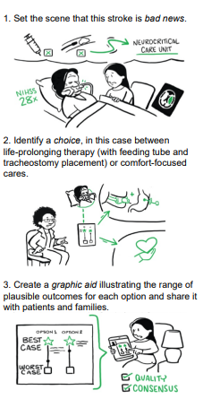
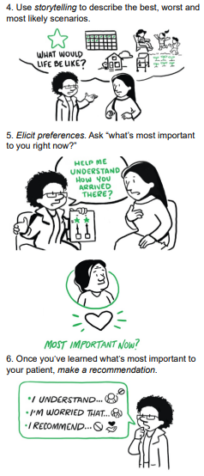
BC / WC Key Components

Slide 17
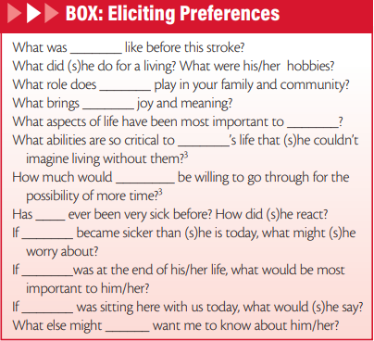
Eliciting Preferences
“Tell me how you’re thinking about this.”
“What’s most important to you right now?”
If the surrogate simply states their decision, you don’t have enough data.
“It sounds like you’ve already decided. Help me
understand how you arrived there.”
Kramer, NM, Besbris J, Dafer, RM. Practical Neurology 2020

Slide 18
Acceptable level of better
How much better do you think Nancy would have to be to have a life that is meaningful for her?
What abilities are so critical to Nancy’s life that she couldn’t imagine living without them?
Serious Illness Conversation Guide. Ariadne Labs

Slide 19
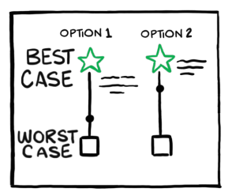
Discuss amongst your team ahead of time
What are the two treatment pathways you are offering?
What is the best anticipated outcome with treatment #1 if all goes well?
  What would life look like in weeks, months, a year?
    Communication, eating, ambulation
    Tie back to personhood and patient preferences
  Where would care be rendered? Could they return home? Would they need 24/7 caregiving?
  How will the patient’s co-morbidities affect overall outcome?
What is the worst anticipated outcome with treatment #1?
  Consider that prolonged suffering may be considered worse than death
  Consider again location of care, expected level of function, and timeframes

Slide 20
Discuss amongst your team ahead of time
What is the most likely outcome along this spectrum?
If Treatment #2 is comfort-focused care, consider:
  Symptoms that may appear at the EOL and what can be done about it
  Location of care: ICU, inpatient hospice, home, etc..
  Will family be able to visit?
  Family preference for location of death
  Pleasure feeding may come up
Ensure that your whole team is on the same page about anticipated range of outcomes
Make a graphic aid that family can keep and reference when sharing information with others

Slide 21
Let’s Practice!

Slide 22
Best Case / Worst Case in a Case of Cardiac Arrest
John is a 73 male comatose patient seven days after cardiac arrest.
Pupillary and corneal reflexes present. Flexion response to pain.
Has diffuse slowing on EEG, evidence of diffuse anoxic injury on MRI, and present SSEPs (mixed prognostic indicators).
Patient values interacting meaningfully with family.
Wife states acceptable level of better is to be able to read to his grandkids again.
If dying, would like to be at home.
Treatment A
Treatment B
Adapted from Kruser JM et al. J Am Geriatr Soc 2016

Slide 23
Best Case / Worst Case in a Case of Cardiac Arrest
Peak recovery 3-6 months in SNF
Eventual home with 24/7 caregiver support after ventilator wean
PEG-dependent
Can maintain arousal and make basic needs known
Will not be able to ambulate independently
Unable to read to grandkids but able to acknowledge their presence
Treatment A: Trach + PEG +
Long Term Care
Treatment B: Compassionate Extubation + Comfort Care
  Doesn’t wake up
  Pain and dyspnea are controlled with PO medications
  Able to return home with hospice services
  Family has time to say goodbye
Death within days - weeks
  Peak recovery 6 months
  LTACH then likely skilled nursing indefinitely
  PEG-dependent
  Periods of wakefulness, but unable to interact or make basic needs known
  Unable to read to grandkids
  Medical complications
  Multiple hospital admissions
  Death within few years
  Doesn’t wake up
Pain and dyspnea are controlled
  Some time for family to gather
Death within days in inpatient hospice
Doesn’t wake up
Pain and dyspnea are difficult to control and require IV medications
Minimal time for family to gather
Death within minutes to hours in ICU
  Doesn’t wake up
  Discomfort from complications and invasive treatments
Death within weeks in ICU
Adapted from Kruser JM et al. J Am Geriatr Soc 2016
Adapted from Steinberg A et al. J Palliat Med. 2022

Slide 24
Best Case / Worst Case in a Case of Cardiac Arrest
Unfortunately, we cannot predict the future for John.
If we proceed with inserting a feeding and breathing tube, I think that the best case scenario is that he will take up to 6 months to recover to the point of being awake and interactive with you by saying simple sentences and following basic instructions. I don’t anticipate he would recover enough language function to be able to read to the grandkids, which I understand was very important to him. He would likely still need help with activities such as feeding, dressing, toileting, walking, and will require skilled nursing care for at least 3-6 months, if not for the long term.
I anticipate the worst case scenario is that he does not wake up from this, he will suffer many complications, and unfortunately die within the intensive care unit despite pursuing all possible interventions.
I think the most likely case is somewhere in between. He will open his eyes, might be able to track you but not interact or talk with you, and will be dependent on a feeding tube for the rest of his life. He likely will have complications related to being bedbound, and may die within a few years.

Slide 25
Best Case / Worst Case in a Case of Cardiac Arrest
An alternative option is to focus on John’s comfort by removing the breathing tube, and honoring whatever time he has left with us.
In the best case scenario, he may be able to return home with hospice support. His pain and breathing will be controlled with medications by mouth. I do not anticipate he will wake up. He might be with us for days to a few weeks, which may allow the family time to say good bye.
In the worst case, pain and shortness of breath will be difficult to control once the breathing tube is removed, and he will require frequent IV medications for comfort. He may die within minutes to hours in the intensive care unit, limiting the time family is able to spend together at his bedside.
In the most likely case, he may experience pain and difficulty breathing, requiring the support of an inpatient hospice unit to keep him comfortable. I anticipate he may die within days, allowing time for family to gather.

Slide 26
Large Group Debrief
What did it feel like to use this framework and phrases?
What was your biggest challenge?
How do you anticipate implementing this tool in your daily practice?
What preparation do you anticipate needing prior to speaking with family?

Slide 27
Pearls
Prognostic uncertainty is the RULE in severe acute brain injury
The Best Case / Worst Case framework can be a tool to help make high-stakes decisions in the setting of prognostic uncertainty
Anticipate spending time formulating the range of possible outcomes with your team prior to presenting this to patients/families.
This framework improves patient/family engagement in decision-making and ensures that treatment decisions are in line with their values and preferences.

Slide 28

Acknowledgement
Margaret “Gretchen” Schwarze MD, Toby Campbell MD, and Amy Zelenski PhD for developing the Best Case / Worst Case framework.
Ellen and Peter O. Johnson Chair in Palliative Care for generously funding this project.
TruScribe for collaboration on the animated video.
Some slides adapted from Winnie Lau MD, Claire Creutzfeldt MD, and EPEC-N Project in collaboration with the International Neuropalliative Care Society.

Slide 29
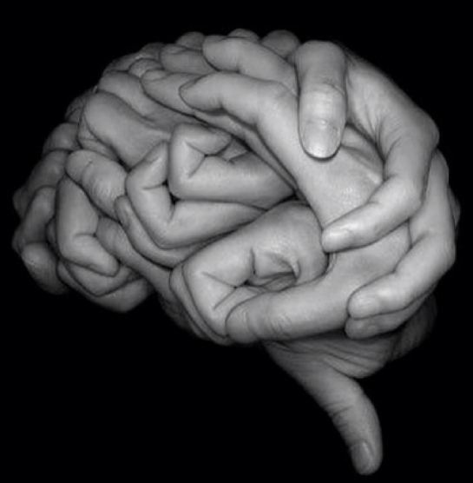
Questions?
Neha_Kramer@rush.edu
Jessica.Besbris@cshs.org
baker@neurology.wisc.edu

